Slide 1

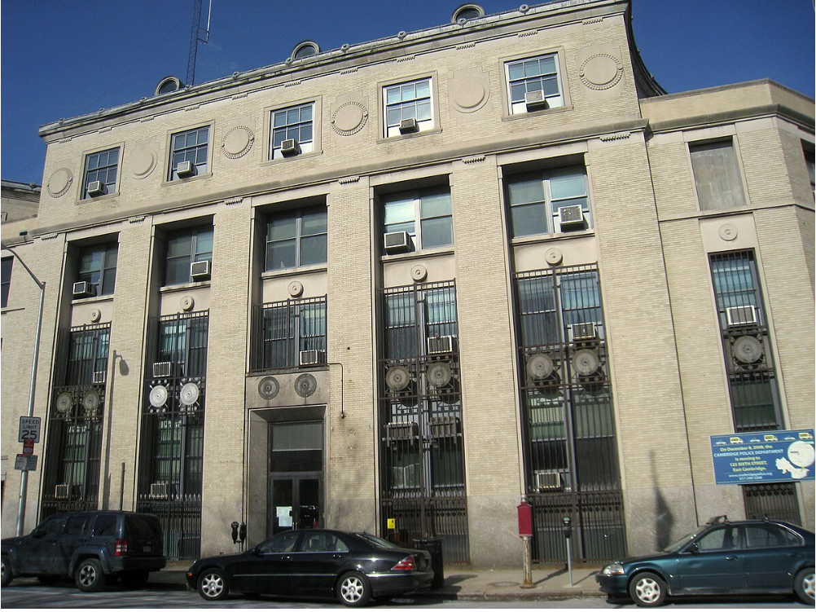
Police Allocation IN Cambridge By Anders Steiness, Aziz Malouche, and Azfal Peermohammed

Slide 2
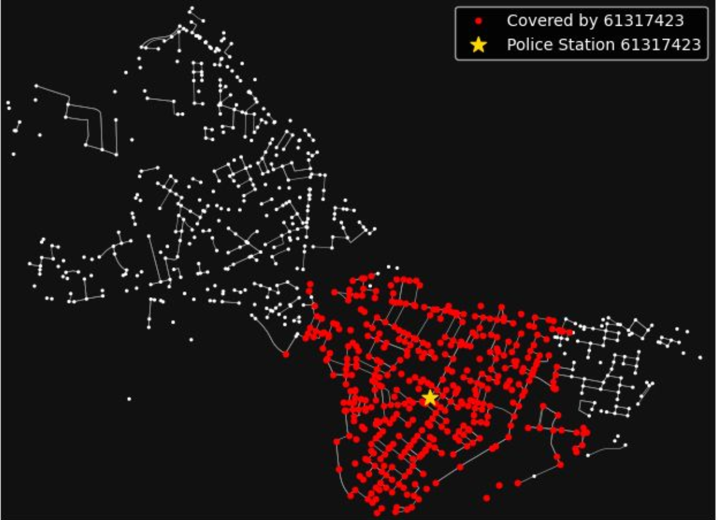
Motivation
Current Day Station
Topics Under Question
Challenge: Urban crime patterns and staffing constraints require optimized police resource allocation to maintain safety and trust.
Approach: Analyze Cambridge crime data to determine optimal station locations and officer staffing.
Impact: Improve response times, solve crimes efficiently, and strengthen community trust in law enforcement.
Scalability: Framework applicable to other cities, promoting equitable and effective resource use nationwide.

Slide 3
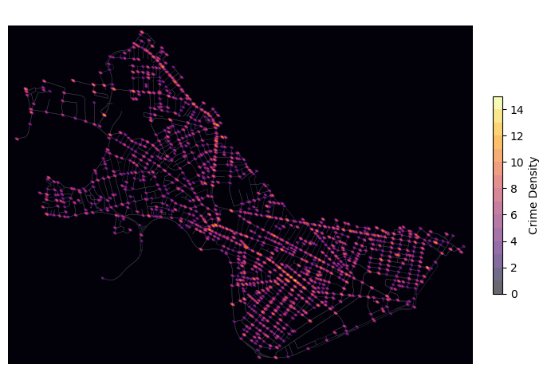
Heatmap of crime in cambridge
Mass Avenue leads the way in crime
Data Generation
Road Structure sourced using osmnx
Distance Matrix computed
Crime Report incl. crime type and address originally from the City of Cambridge Police Department
Crime Longitude and Latitude gathered using Google Maps API
Mapped crime to nearest node
Crime Data Used from 2020 to 2024
Out-of-sample data: 2024

Slide 4
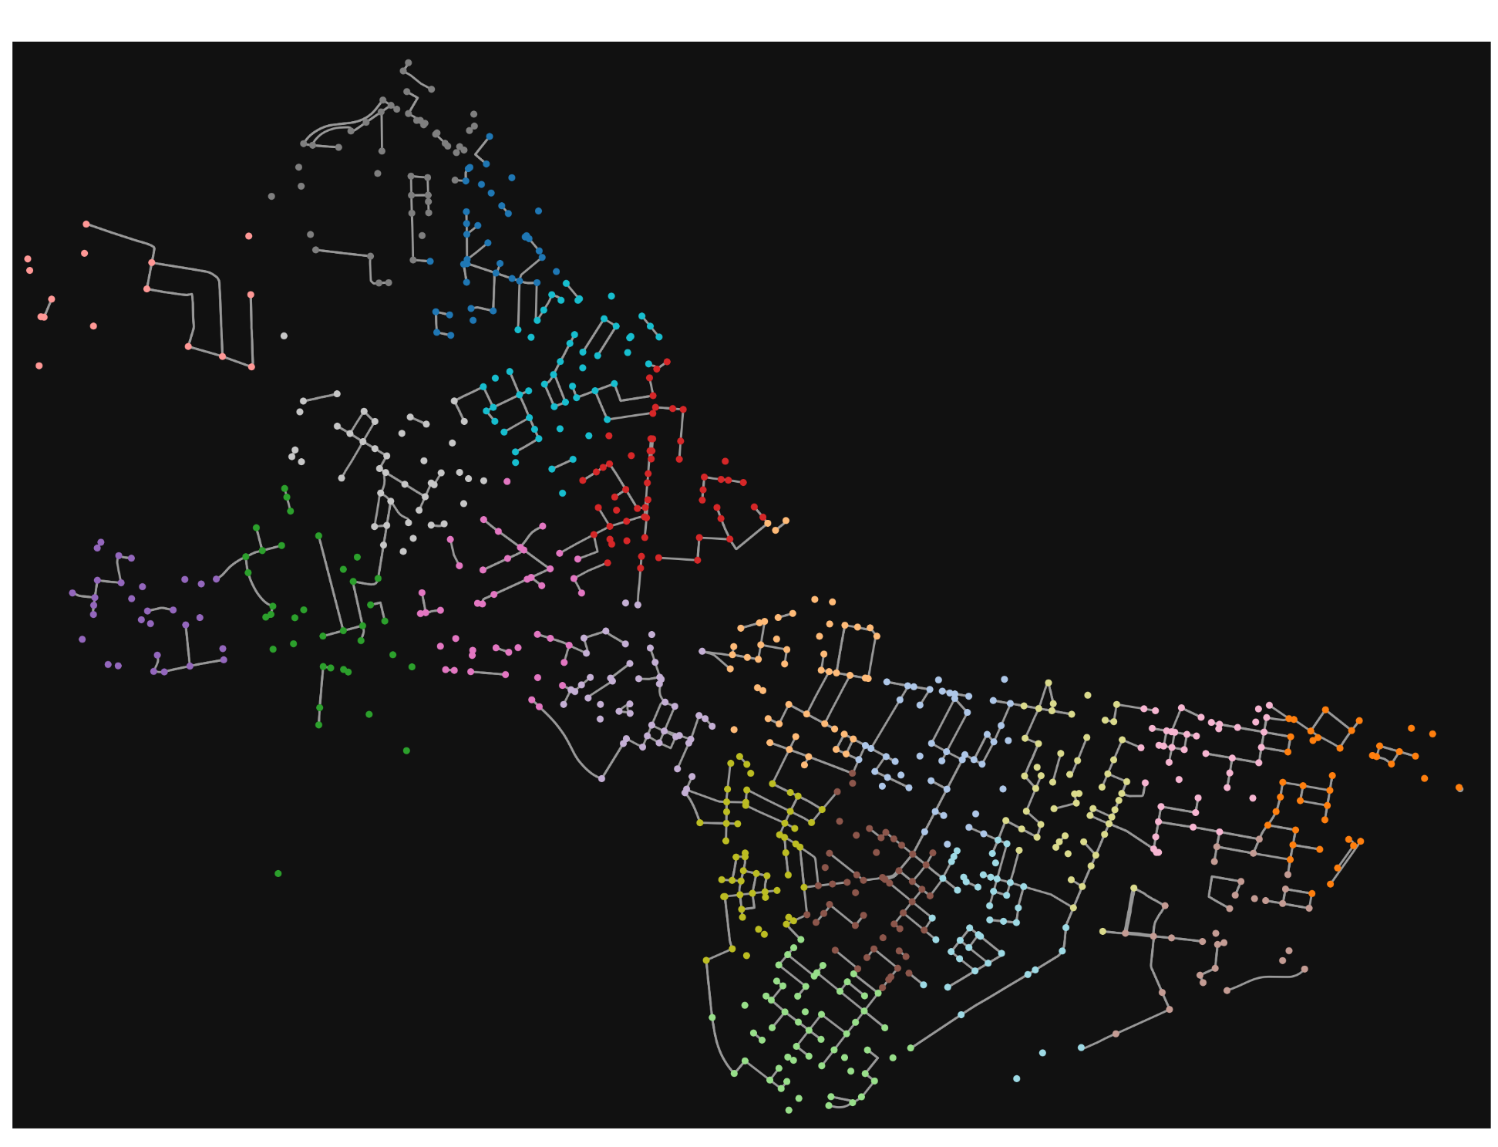
Downsampled graph
900 Nodes Subgraph for Computational Purposes
Downsample Procedure
K-means clustering with 20 clusters (100 random initialization) based on longitude and latitude data
Randomly sampled 45 nodes from each cluster
Remapped Crime to closest node in new subgraph
Computationally more feasible problem

Slide 5
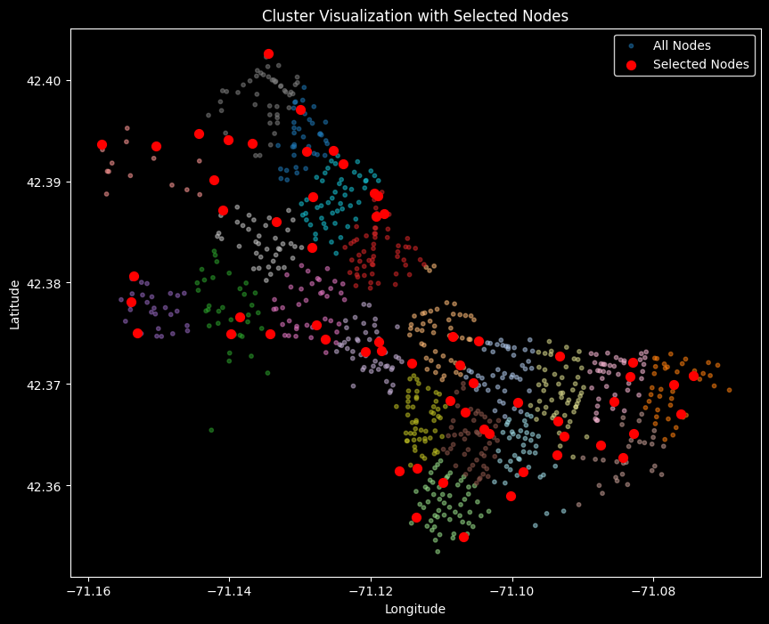
Police station candidate nodes
60 Selected Candidate Nodes
Candidate Nodes for Police Station Procedure
K-means clustering with 20 clusters (100 random initialization) based on longitude and latitude data
Selected the two nodes with highest crime in each cluster
Computationally practical problem

Slide 6
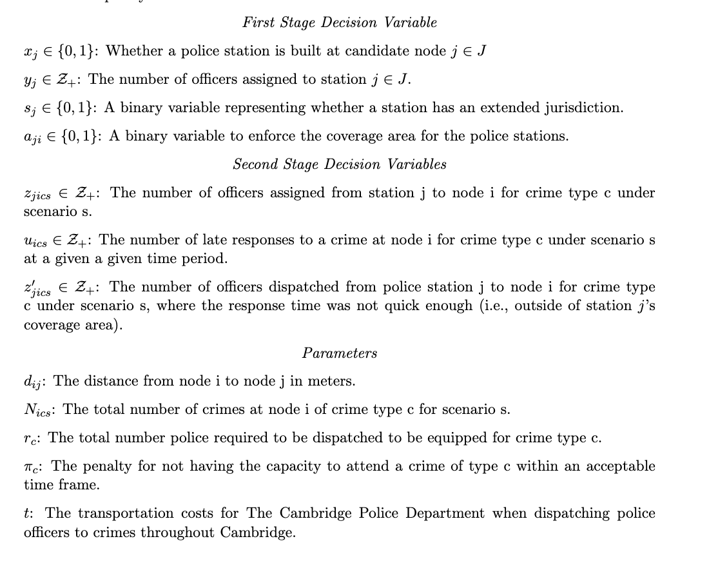
Model formulation
Decision Variables and Parameters
Optimization Methods
Adaptive Stochastic Optimization
Deterministic Optimization
Baseline Non-Optimization Model
First Stage Decision Variables
Police Station Facility Location
Police Officers Assignment to Stations
Second Stage Decision Variables
Police Officer Dispatchment from Station j to Crime at Node i

Slide 7
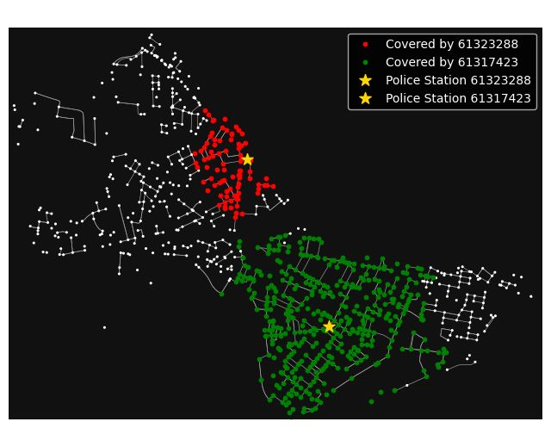
Model Considerations
Large vs. Small Coverage Area
First Stage Decision Variables
Police Station Facility Location
Police Officers Assignment to Stations
Second Stage Decision Variables
Police Officer Dispatchment from Station j to Crime at Node i
Model Consideration
Police Station Can Have Large Coverage Area (2000 meters) or Small Coverage Area (1000 meters)
If Crime Outside Coverage Area, then the Crime will not be met on Time and Cost is Incurred
If Overlapping Coverage Area, Police Will be Dispatched from Nearest Station

Slide 8
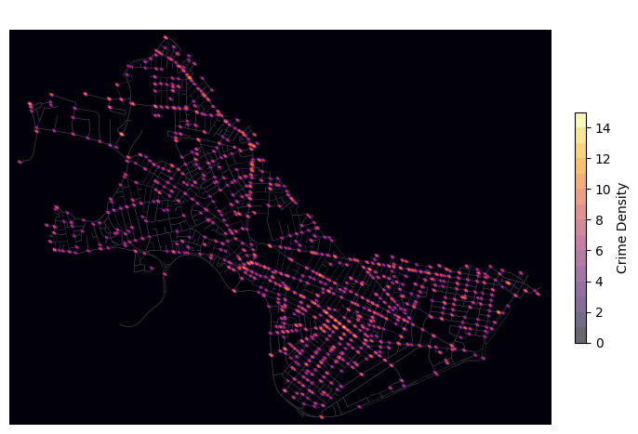

Realistic scenario generation
2022 Heatmap of Crime in Cambridge
2023 Heatmap of Crime in Cambridge

Slide 9
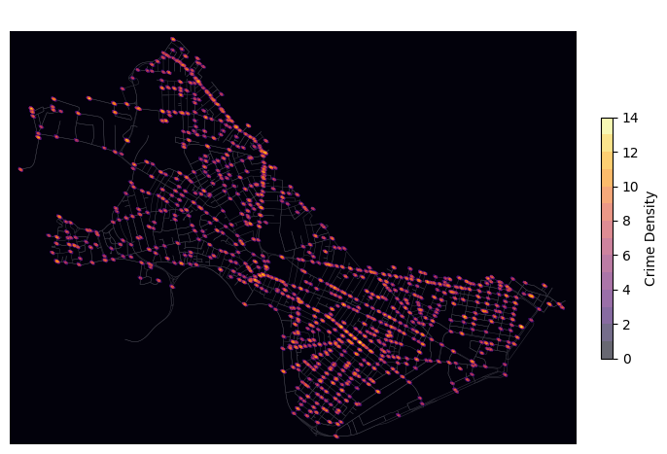
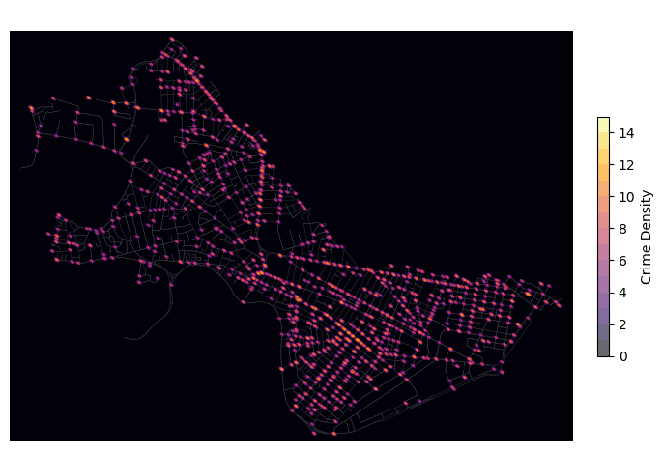
covid Scenario generation with unusual crime dynamics – to test limits of adaptive stochastic model’s performance
2020 Heatmap of Crime in Cambridge
2021 Heatmap of Crime in Cambridge

Slide 10
2024 RESULTS (2 Stations)
2024 | Cost | Late Crimes | Late Officers
Random Baseline | $113M | 2,145 | 10,378
Highest Crime Baseline | $63M | 1,064 | 5,284
K-Means Baseline | $64M | 1,056 | 5,320
Present Day Baseline | $60M | 1,028 | 5,100
Deterministic Optimization | $49M | 843 | 4,124
Adaptive Optimization | $49M | 843 | 4,124

Slide 11
2024 RESULTS (3 Stations)
2024 | Cost | Late Crimes | Late Officers
Random Baseline | $70M | 1,242 | 6,114
Highest Crime Baseline | $51M | 827 | 4,152
K-Means Baseline | $37M | 635 | 3,138
Present Day Baseline | $48M | 836 | 4,094
Deterministic Optimization | $29M | 513 | 2,482
Adaptive Optimization | $15M | 234 | 1,152

Slide 12
RESULTS (3 Stations w/ COVID Scenarios)
2024 | Cost | Late Crimes | Late Officers
Random Baseline | $70M | 1,238 | 6,102
Highest Crime Baseline | $50M | 828 | 4,130
K-Means Baseline | $37M | 630 | 3,114
Present Day Baseline | $47M | 831 | 4,062
Deterministic Optimization | $27M | 464 | 2,280
Adaptive Optimization | $31M | 526 | 2,640
Notes:
Deterministic goes from 29M to 27M
Adaptive goes from 16M to 31M. Terrible!!

Slide 13
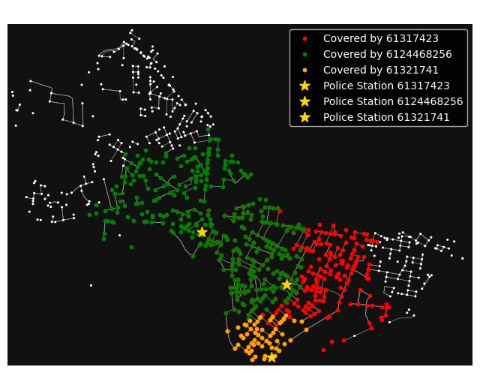
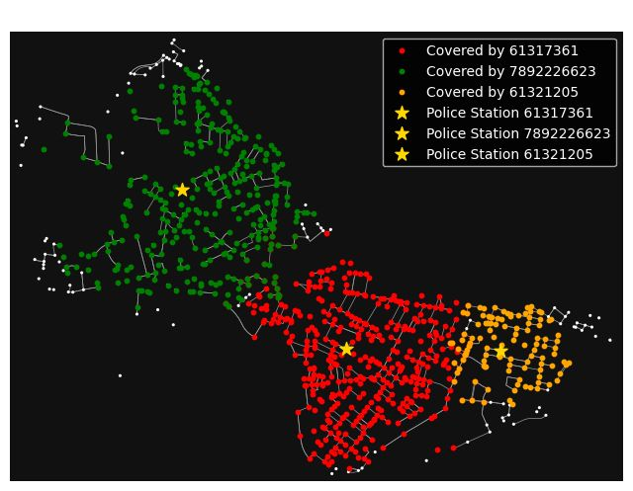
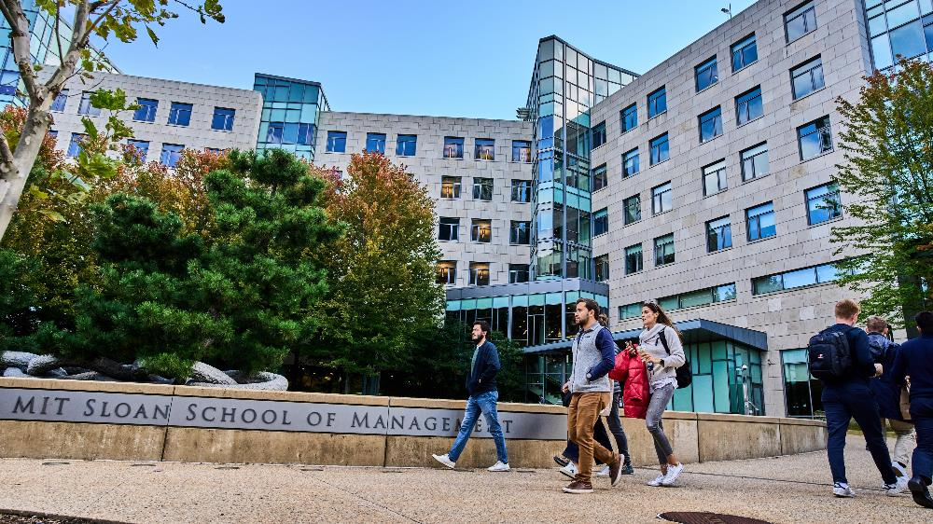
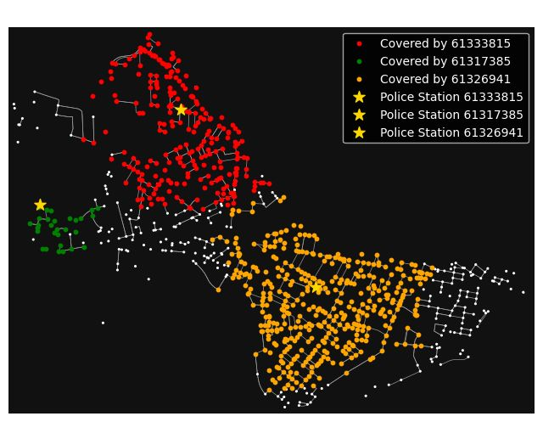
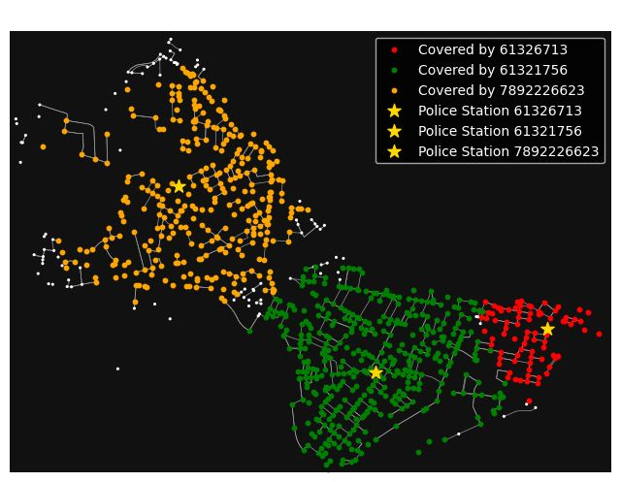
2024 Models for 3 Stations
Current Baseline: Lowest on time node coverage and worst performance.
K-Means: Has very high on time node coverage
Deterministic: Focuses on high-crimes, outperforming K-Means and demonstrating mere coverage isn’t necessarily optimal
Adaptive: Achieves the best overall performance with high coverage
Figure 1: Current Baseline
Figure 2: K-Means Baseline
Figure 3: Deterministic
Figure 4: Adaptive

Slide 14
Key Findings and Takeaways
Strength of Adaptive Model and Optimization
Alignment Between In-Sample and Out-of-Sample Results
Limitations of Using COVID Scenarios for Crime Patterns
Consistent Performance: Deterministic and adaptive models outperform all four baselines
Random
Top 3 crimes
K-means
Existing station
Adaptive Reduces Late Crimes:
By ~50% compared to deterministic
2.5x more compared to K-Means
3.5x more compared to Top Crime Node Baseline
2022-23 Results
Adaptive optimization reduced costs to of $33,945,299 and late crimes to 1,169, the lowest among all models
2024 Results
Adaptive optimization reduced costs to $14,508,239 and late crimes to 234, again the lowest among all models.
Impact of Including 2020–2021 Adding scenarios from 2020 and 2021, alongside 2022 and 2023, worsened adaptive performance.
Reason
COVID years were not representative of current or future crime patterns.
Key Insight
Uncalibrated scenarios can hinder the effectiveness of the adaptive stochastic method's solution.

